Slide 1
R2RClient Installation SOP For R2RClient Version 1.0.x
Andy Hu
2021-02-01

Slide 2
Outline
Packages
Installation
Deployment Structure
Preparation
Install Etch API
Install Litho API
Install Client Deployer
Clean Uninstallation
FAQ

Slide 3

Packages
MSI Installers
R2RClient.EtchAPI.Setup – 1.0.x.x.msi
R2RClient.LithoAPI.Setup – 1.0.x.x.msi
R2RClient.Deployer.Setup – 1.0.x.x.msi
LoginService Package
TBD.
Dependencies
E3
.NET Framework 4.7.2 SDK
.NET Core Hosting Bundle 3.1.8
SQL

Slide 4
Installation - Deployment Structure
R2R AP Server1
ClickOnce Start Location
R2R Client PC 1
Deployer web site
http://R2RAP1IP:8050/R2RClient.application
Install/Upgrade UI
R2R Client UI
Etch API web site
Litho API web site
R2R Client PC 2
Connect APIs
R2R Client UI
LB & Failover
R2R AP Server2
LB & Failover
…
Etch API Address
http://R2RVirtualIP:8051/api
Etch API web site
R2R Client PC N
Litho API web site
R2R Client UI
http://R2RVirtualIP:8052/api
Litho API Address
Typically, all the APIs are installed on both R2R AP Servers for the purpose of loading balance and failover, while the R2R Client Deployer is only installed on one of them.

Slide 5


Installation - Preparation
Install Prerequisites
.Net Framework 4.7.2 SDK (required by R2R Client Deployer)
It may require a system restart so it should be installed ahead of PRD go-live.
Download Link: https://dotnet.microsoft.com/download/thank-you/net472-developer-pack
File Name: NDP472-DevPack-ENU.exe
.Net Core Hosting Bundle 3.1.8 (required by R2R Client APIs)
Donwload Link: https://dotnet.microsoft.com/download/dotnet-core/thank-you/runtime-aspnetcore-3.1.8-windows-hosting-bundle-installer
File Name: dotnet-hosting-3.1.8-win.exe
Add In/Out allow connection rules in Windows Firewall with Advanced Security for TCP ports:
8050 (R2R Client Deployer web site)
8051 (R2R Client Etch API web site)
8052 (R2R Client Litho API web site)
8053 (R2R Client *** API web site, reserved)

Slide 6
Outline
Packages
Installation
Deployment Structure
Preparation
Install Etch API
Step 1: Stop Web Site
Step 2: Run Installer
Step 3: Change Configuration
Step 4: Start Web Site
Install Litho API
Install Client Deployer
Clean Uninstallation
FAQ

Slide 7
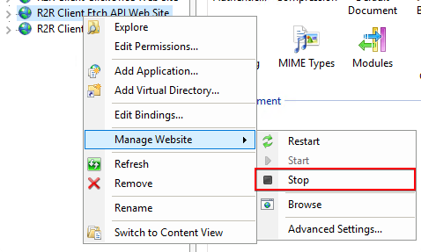
Install Etch API - Step 1: Stop Web Site
Only for Upgrade Installation.
Open IIS Manager, stop R2R Client Etch API Web Site.

Slide 8
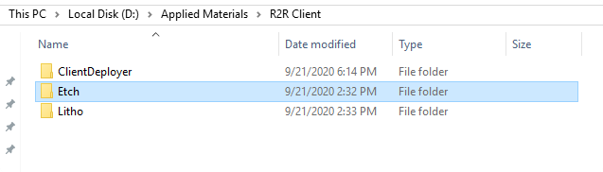
Install Etch API - Step 2: Run Installer
Run R2RClient.EtchAPI.Setup - 1.0.x.x.msi
Use the same parent folder for all the R2R Client components

Slide 9
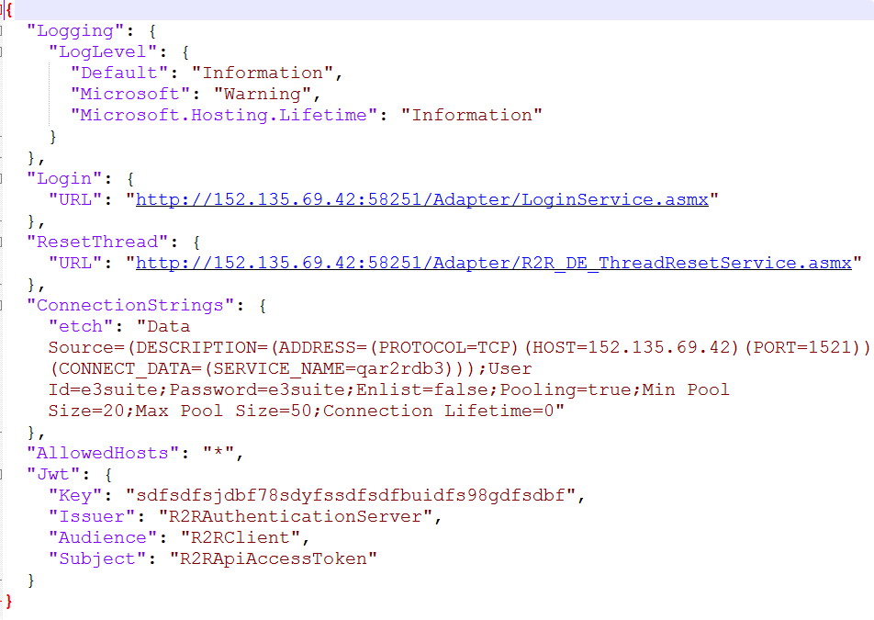
Install Etch API - Step 3: Change Configuration
This Step is only for New Installation or Configuration Changing.
Make sure you back up the configuration files if you need to change configuration for this version.
In the case of rollback, you need to restore the config files by the backed-up config files.
Edit D:\Applied Materials\R2R Client\Etch\appSettings.Production.json
Login: Change the IP address to use correct service.
ResetThread: Change the IP address to use correct service.
ConnectionStrings – Etch: Edit below fields with correct DB Info
HOST
SERVICE_NAME
User Id
Password
Save and Close

Slide 10
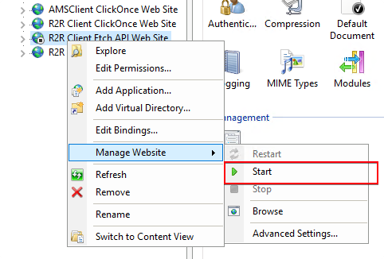
Install Etch API - Step 4: Start Web Site
Open IIS Manager, Start/Restart R2R Client Etch API Web Site.

Slide 11
Outline
Packages
Installation
Deployment Structure
Preparation
Install Etch API
Install Litho API
Step 1: Stop Web Site
Step 2: Run Installer
Step 3: Change Configuration
Step 4: Start Web Site
Install Client Deployer
Clean Uninstallation
FAQ

Slide 12
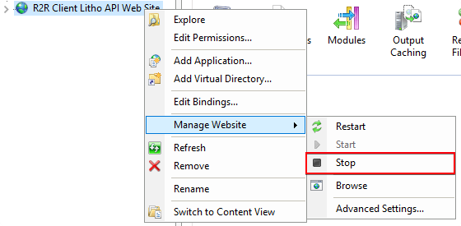
Install Litho API - Step 1: Stop Web Site
Only for Upgrade Installation.
Open IIS Manager, stop R2R Client Litho API Web Site.

Slide 13
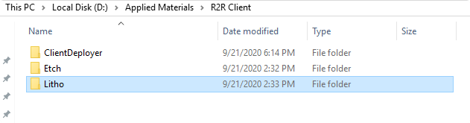
Install Litho API - Step 2: Run Installer
Run R2RClient.LithoAPI.Setup - 1.0.x.x.msi
Use the same parent folder for all the R2R Client components

Slide 14
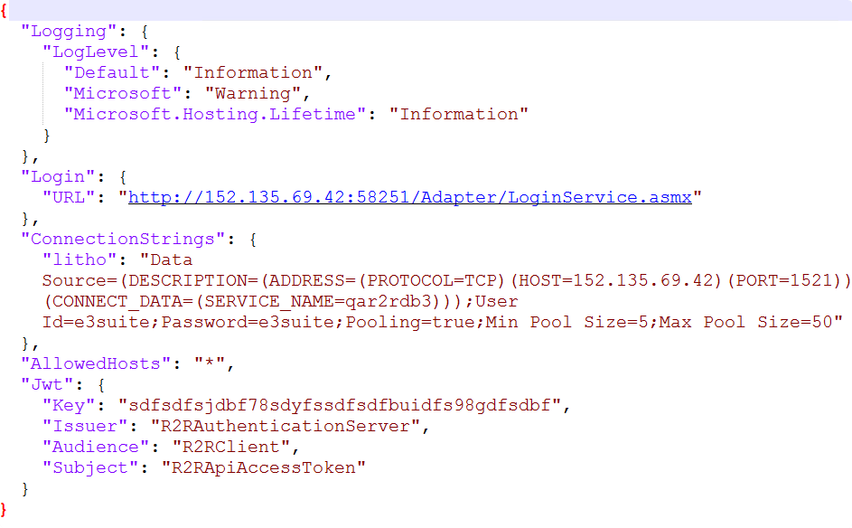
Install Litho API - Step 3: Change Configuration
This Step is only for New Installation or Configuration Changing.
Make sure you back up the configuration files if you need to change configuration for this version.
In the case of rollback, you need to restore the config files by the backed-up config files.
Edit D:\Applied Materials\R2R Client\Litho\appSettings.Production.json
Login: Change the IP address to use correct service.
ResetThread: Change the IP address to use correct service.
ConnectionStrings – Etch: Edit below fields with correct DB Info
HOST
SERVICE_NAME
User Id
Password
Save and Close

Slide 15
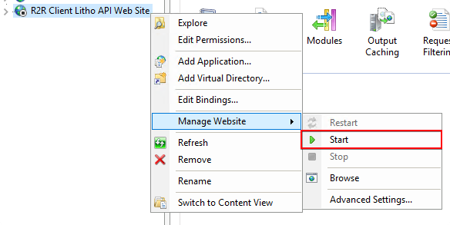
Install Litho API - Step 4: Start Web Site
Open IIS Manager, Start/Restart R2R Client Litho API Web Site.

Slide 16
Outline
Packages
Installation
Deployment Structure
Preparation
Install Etch API
Install Litho API
Install Client Deployer
Step 1: Stop Web Site
Step 2: Run Installer
Step 3: Change Configuration
Step 4: Deploy ClickOnce Version
Step 4: Start Web Site
Step 5: Test Run Client
Clean Uninstallation
FAQ

Slide 17
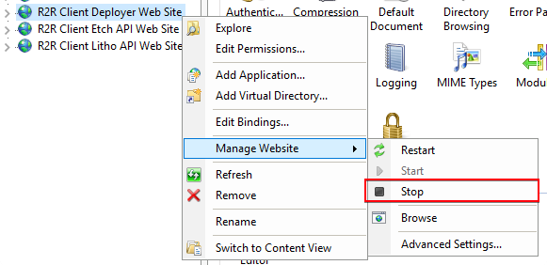
Install Client Deployer - Step 1: Stop Web Site
Only for Upgrade Installation.
Open IIS Manager, stop R2R Client Deployer Web Site.

Slide 18
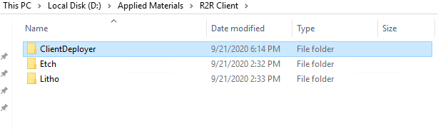
Install Client Deployer – Step 2:Run Installer
Run R2RClient.Deployer.Setup - 1.0.x.x.msi
Use the same parent folder for all the R2R Client components

Slide 19
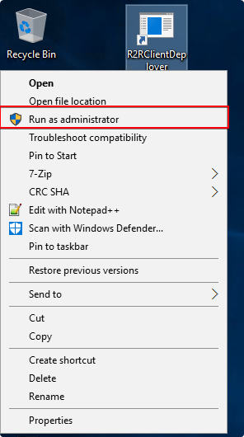
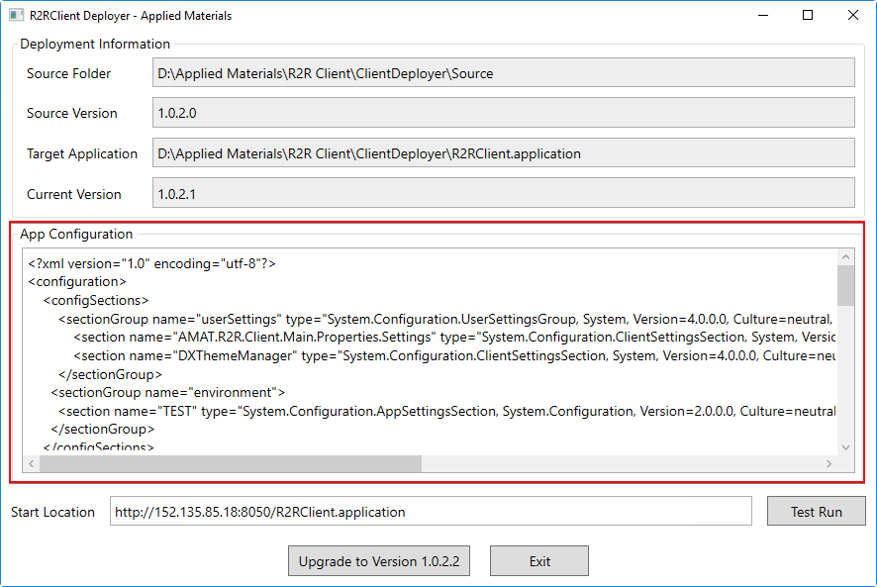
Install Client Deployer – Step 3: Change Configuration
Only required for New Installation or Configuration Changing.
On desktop, right lick on “R2RClientDeployer” and select “Run as Administrator”
Change the configuration in “App Configuration” textbox following samples in Next Pages

Slide 20
Install Client Deployer – Step 3: Change Configuration
<sectionGroup name="environment">
<section name="PRD" type="System.Configuration.AppSettingsSection, System.Configuration, Version=2.0.0.0, Culture=neutral, PublicKeyToken=b03f5f7f11d50a3a"/>
<section name="TEST" type="System.Configuration.AppSettingsSection, System.Configuration, Version=2.0.0.0, Culture=neutral, PublicKeyToken=b03f5f7f11d50a3a"/>
</sectionGroup>
Define section in environment sectionGroup
Pay attention to the environment section name
NOTE: In the case of rollback, you need to restore the configuration from configuration file in the old-version’s folder.

Slide 21
Install Client Deployer – Step 3: Change Configuration
<environment>
<PRD>
<add key="Name" value=" Production"/>
<add key="Order" value="1"/>
<add key="ServerHost" value="152.135.69.42"/>
<add key="AreaPortMap" value="Etch:8051,Litho:8052"/>
<add key="FABList" value="FAB1,FAB2"/>
<add key="FAB1.AreaList" value="Etch,Litho"/>
<add key="FAB2.AreaList" value="Etch,Litho,CMP"/>
<add key="DefaultFab" value="FAB1"/>
<add key="DefaultArea" value="Etch"/>
<add key="DomainList" value="AMAT,CNXA-DEV-27"/>
<add key="DefaultDomain" value="CNXA-DEV-27"/>
</PRD>
<TEST>
<add key="Name" value="CNXA-DEV-27 QA"/>
<add key="Order" value="2"/>
<add key="ServerHost" value="152.135.69.42"/>
<add key="AreaPortMap" value="Etch:8051,Litho:8052"/>
<add key="FABList" value="FAB1,FAB2"/>
<add key="FAB1.AreaList" value="Etch,Litho"/>
<add key="FAB2.AreaList" value="Etch,Litho,CMP"/>
<add key="DefaultFab" value="FAB1"/>
<add key="DefaultArea" value="Etch"/>
<add key="DomainList" value="AMAT,CNXA-DEV-27"/>
<add key="DefaultDomain" value="CNXA-DEV-27"/>
</TEST>
</environment>
Add/edit each environment, use the section name defined in sectionGroup.
Modify setting values for environments.
Setting Key | Format | Description
Name | string | Environment name displayed under the Env dropdown list for user to choose on Login screen.
Order | integer | The order listed in the Env dropdown.
ServerHost | string | Should be the current Server’s machine name or IP address which is accessible from the client computers. Should use the virtual IP shared between multiple servers in the loading balance and failover case.
AreaPortMap | list | The Area Port maps, default to use Etch:8051,Litho:8052, unless the ports are changed.
FABList | list | Supported fabs.
FABn.AreaList | list | Define available area list for FABn.
DefaultFab | string | Default Fab when this Env is selected.
DefaultArea | string | Default Area when this Env is selected.
DomainList | list | List of Domain or machine name of allowed user accounts.
DefaultDomain | string | Default Domain when this Env is selected.

Slide 22
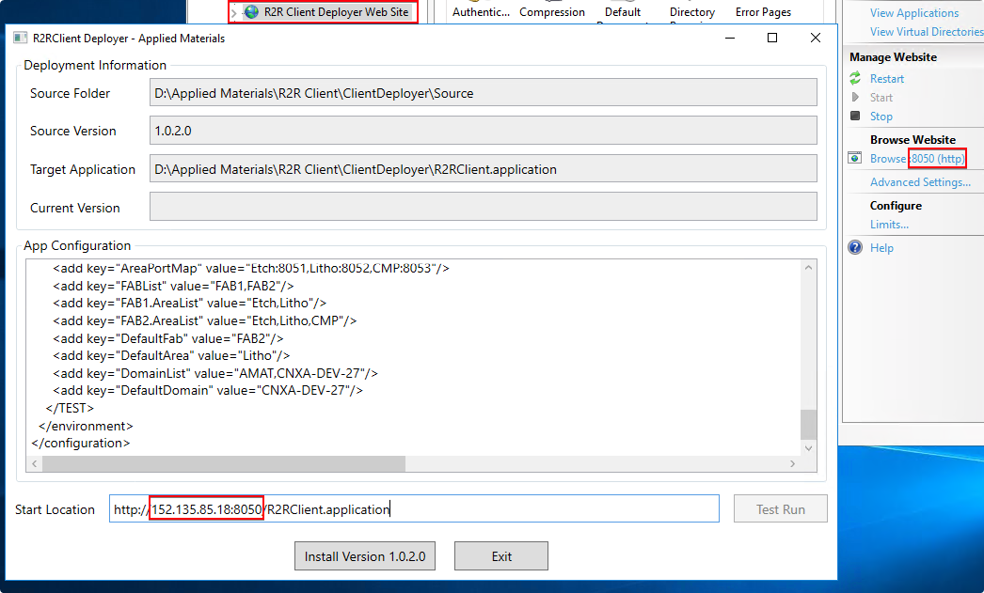
Install Client Deployer – Step 3: Change Configuration
Change the Start Location URL to use the current Server’s IP as the host, and the correct http port number (same as the R2R Client Deployer Web Site’s binding port)

Slide 23
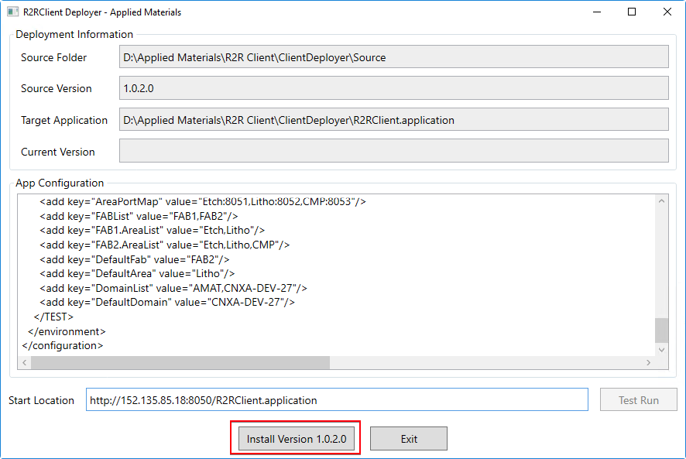
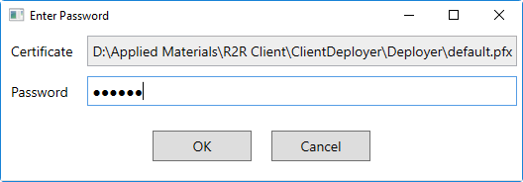
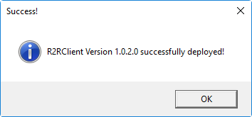
Install Client Deployer – Step 4: Deploy ClickOnce Version
Click “Install/Upgrade to Version 1.0.x.x” button to start the ClickOnce deployment
Enter Password 123456 in password box.
Wait for the upgrade succeed message.

Slide 24
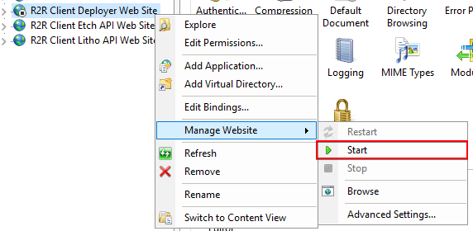
Install Client Deployer - Step 5: Start Web Site
Open IIS Manager, Start/Restart R2R Client Deployer Web Site.

Slide 25
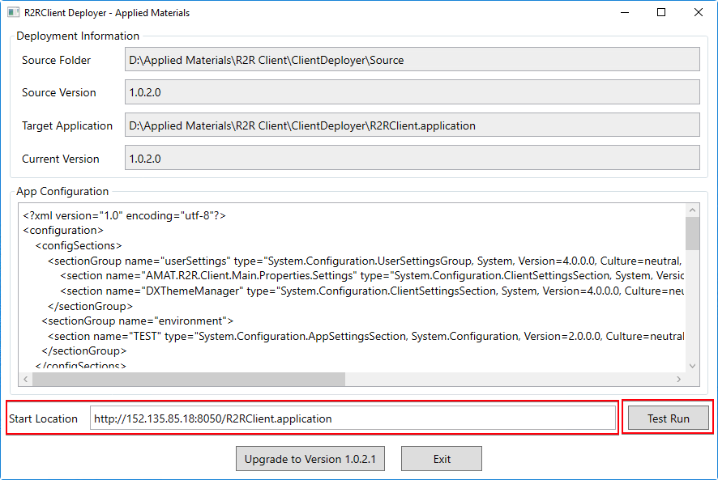
Install Client Deployer – Step 6: Test Run Client
Click “Test Run” on Deployer to install/upgrade the R2R Client. Follow the instructions in next page to complete the installation/upgrade.
When the installation/upgrade is finished, the R2R Client window will popup automatically. Check the Client and Server installed and configured correctly in following ways:
Information shown on Login screen are correct (consistent with Deploy ClickOnce – Step1).
Log in successfully.
The Connection/DB/Version info shown on the status bar are correct (consistent with Deploy ClickOnce – Step1 and appSettings.Production.json).
Functions such as queries by ProcessList, ContextList behaves normally.
If Test Run succeeded, share the Start Location URL with End Users for installation/upgrade.
If Test Run failed, check the configuration files/deployer configuration/website status & ports/firewall settings mentioned in previous pages, correct the errors and repeat the related steps if needed. See the last page to Do Rollback if needed.

Slide 26
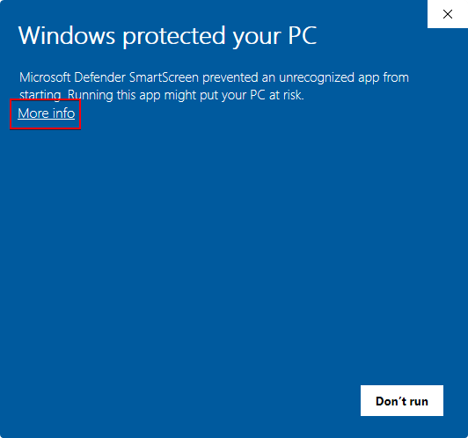
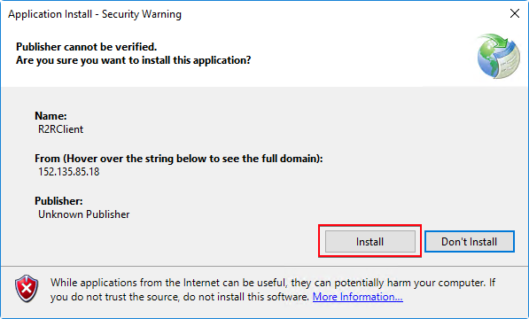
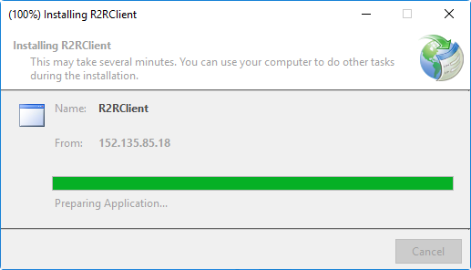
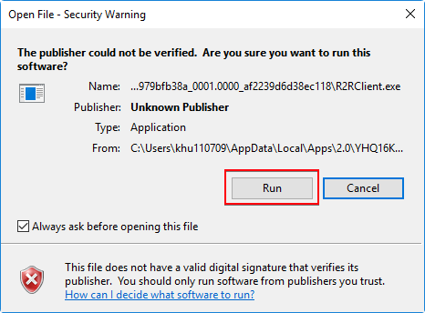
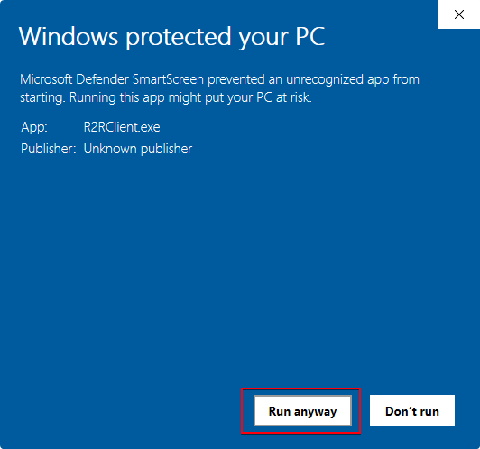
Install Client Deployer – Step 6: Test Run Client
Windows 10
Windows Server 2016
NOTE: The Security Warning should be ignored during the installation in order to run the R2R Client.
The appearance of the warning message box could be different depends on the version of OS.
Uncheck

Slide 27
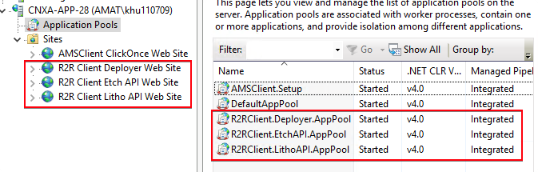
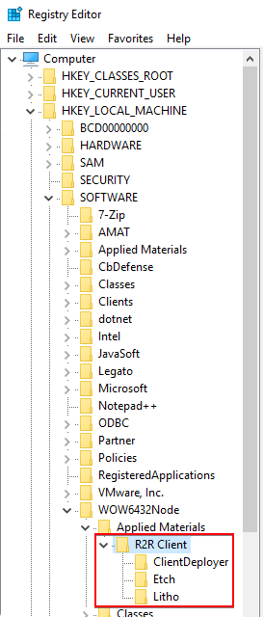
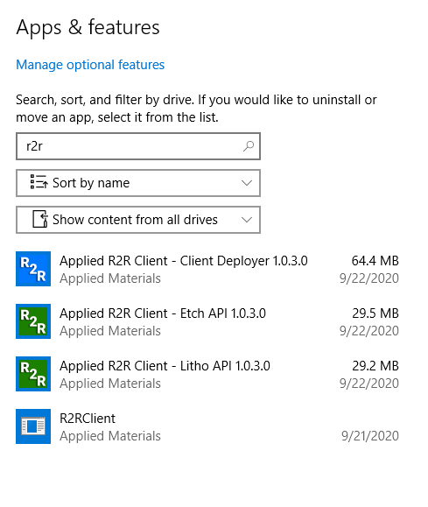
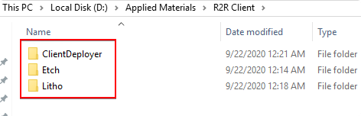
Clean Uninstallation
Open IIS Manager, stop the web sites to be removed.
Open Apps & Features or Program and Features
Uninstall the components.
Remove the corresponding websites and application pools.
Run “regedit”, remove registry item HKEY_LOCAL_MACHINE\SOFTWARE\WOW6432Node\Applied Materials\R2R Client
Remove the left files and folders in the installation path.

Slide 28
FAQ1
When should I do the Clean Uninstallation?
You do Clean Uninstallation when you want to thoroughly remove R2R Client from the machine or you need to do a New Installation.

Slide 29
FAQ2
How to do Upgrade Installation with new version installers and configuration?
Normally you don’t have to uninstall the current version, just start with each of below sections:
Install Etch API
Install Litho API
Install Client Deployer
Upgrade Installation can be done partially depends on which installers are provided.
How to do Upgrade if only configuration is to be updated?
For API web sites, just modify the config files and restart the web site (e.g. Install Etch API - Step3 and Step4).
For Client configuration, you need to go through Install Client Deployer but skip Step2.

Slide 30
FAQ3
Why don’t perform manual Uninstallation before Upgrade Installation?
The new version installers can do the uninstallation automatically before installing new files.
Will the configuration be removed if I manually uninstall the components from Apps & Features or Program and Features?
No. Stuff related with configuration will be kept after uninstallation. Such as web sites with application pools, configuration files, old version deployment infos, registry items etc.
By keeping config-related items unremoved, the new version can inherit the configuration from the previous version, and you don’t have to backup the configuration before upgrading.

Slide 31
FAQ4
What will be left if I uninstall the components in Apps & Features or Program and Features?
For API, web sites with application pools and configuration files (appsettings.Production.json and web.config) will be left.
For Deployer, web site with application pool and below files are left:
Version folders and AppBackup folder
Index.htm
R2RClient.application
For all the components, registry items are left at
HKEY_LOCAL_MACHINE\SOFTWARE\WOW6432Node\Applied Materials\R2R Client

Slide 32
FAQ5
Can the port numbers be changed?
The port numbers don’t have to be 8050-8053. They can be modified and should be consistently modified according to the configuration steps. DO NOT change any port number after production deployment.
How does the client application check new version and do the upgrade?
The R2R Client (UI) uses ClickOnce protocol. Each time the Client application starts, it will first check the new version by the Start Location URL (e.g. http://deployerHost:8050/R2RClient.application), if a new version is found, it will upgrade automatically; otherwise, it will open the UI normally.

Slide 33
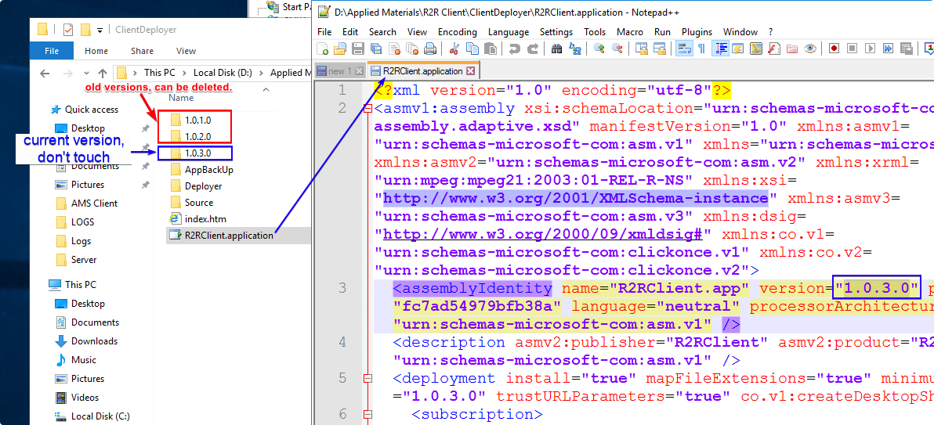
FAQ6
What can be changed manually under ClientDeployer folder?
Don’t modify the files or folders under ClientDeployer. They are either installed files or generated and should only be updated by the R2RClient Deployer application.
However, the old version folders are archives and they can be deleted if you want to save space.

Slide 34
FAQ7
How to do Rollback?
Uninstall the 3 components from Apps & Features.
Install previous version of each component according to below sections, pay attention to the configuration rollback if needed
Install Etch API
Install Litho API
Install Client Deployer and do a new version upgrade deployment.
NOTE: Client Deployer will upgrade the last version number based on the new version.
For example, if you rollback from 1.0.3.0 to 1.0.2.0, after the rollback, the Current Version shown in Client Deployer is 1.0.3.0, the Current Version shown in Client Deployer is 1.0.3.1, and the Source Version is 1.0.2.0.

